Slide 1
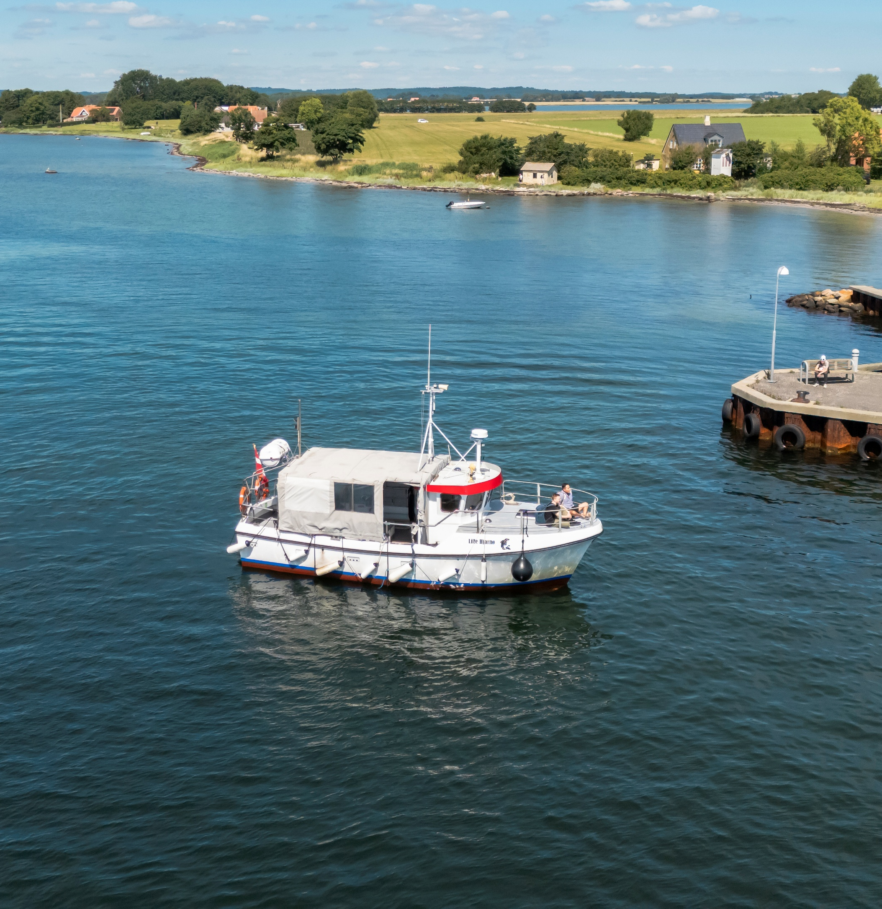
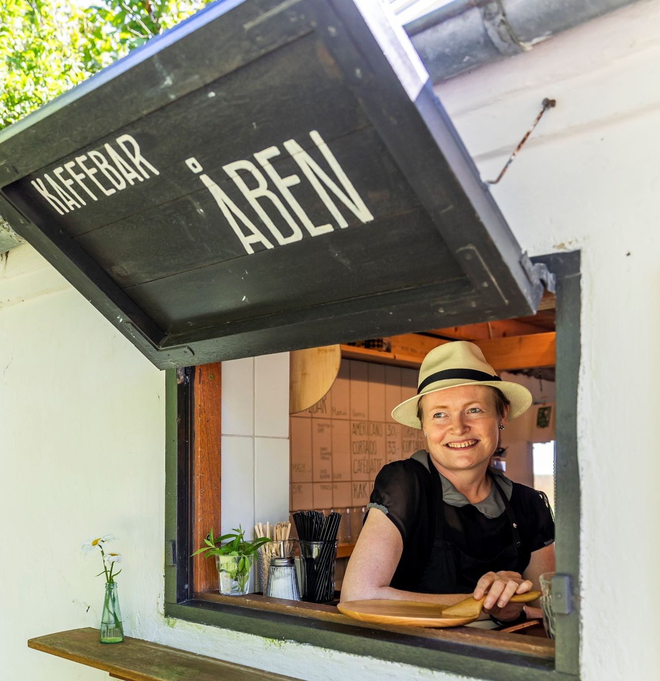
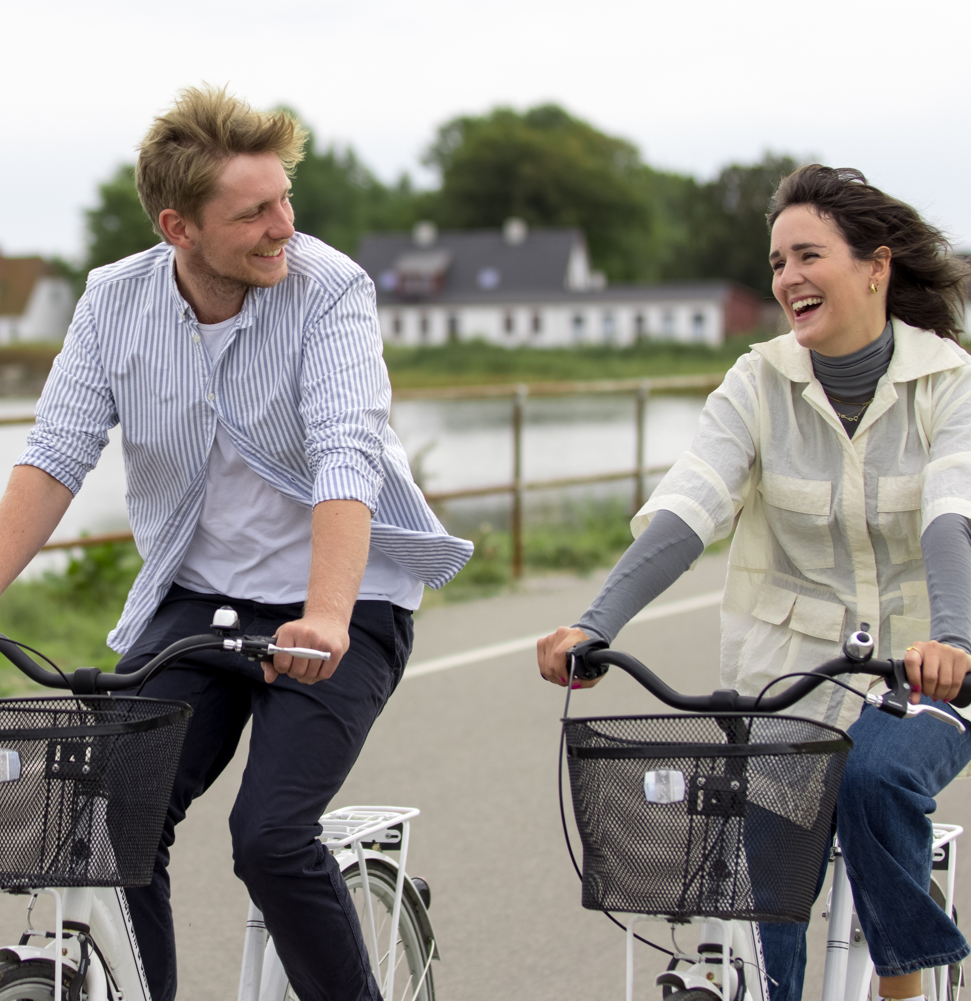
Kystlandet
Kystlandet (in English ‘The Coastal Land’) is a small, charming destination in the eastern part of mainland Denmark. Famous for its laid-back atmosphere, informal and unpretentious way of life, and the love of quality over quantity, Kystlandet is the perfect place for a slow-paced stay – perfectly in tune with the soothing, bobbing waves of the region’s shallow fjords and calm coastlines.
Explore the charming old fjord-town of Horsens, where history and culture come to live, and embrace island hopping the Danish way in the East Jutland Archipelago by hopping over the enchanting islands of Alrø, Hjarnø (full of Viking myths!) and Endelave, where you’ll meet the adorable wild rabbits. These furry companions will capture your heart with their playful nature and fluffy charm which stands in stark contrast to the cold, slippery seaweed which you’ll be harvesting yourself from the Kattegat Sea between Denmark and Sweden on a seaweed-safari with local guide, Bjarne.
The area also tantalizes the taste buds with its culinary qualities and traditional dishes. Indulge in the flavors of Denmark as you savor locally grown produce, picked up from of the many roadside stalls, and freshly baked sourdough bread from a rustic farm shop or the organic micro-bakery, GROFT, near Saksild Beach – awarded one of the best in Denmark! Or immerse yourself in the local gastronomy by sampling traditional Danish dishes like smørrebrød (iconic open-faced sandwiches) topped with an array of local ingredients incl. fresh seafood from the cold waters – or freshly picked new potatoes from one of the archipelago’s small islands. In the sweet spot between the coast of East Jutland and the River Gudenå to the west, Kystlandet also offers versatile and beautiful nature perfect for biking and hiking. It’s located side by side with vibrant cities that will entice you with shopping, culture and history, such as FÆNGSLET – one of Europe’s biggest prison museums. There are things for the majority of people here – and most of us come again and again to experience the very special atmosphere, full of peace and tranquility. That’s how it is in Kystlandet. This applies to both everyday and holiday life, because slow living is a virtue here and slow travel is the way to enjoy your holiday.
With our rich heritage, captivating sights, and thrilling adventures, Kystlandet is a ”must see” destination that promises to leave you with cherished and very Danish memories.

Slide 2
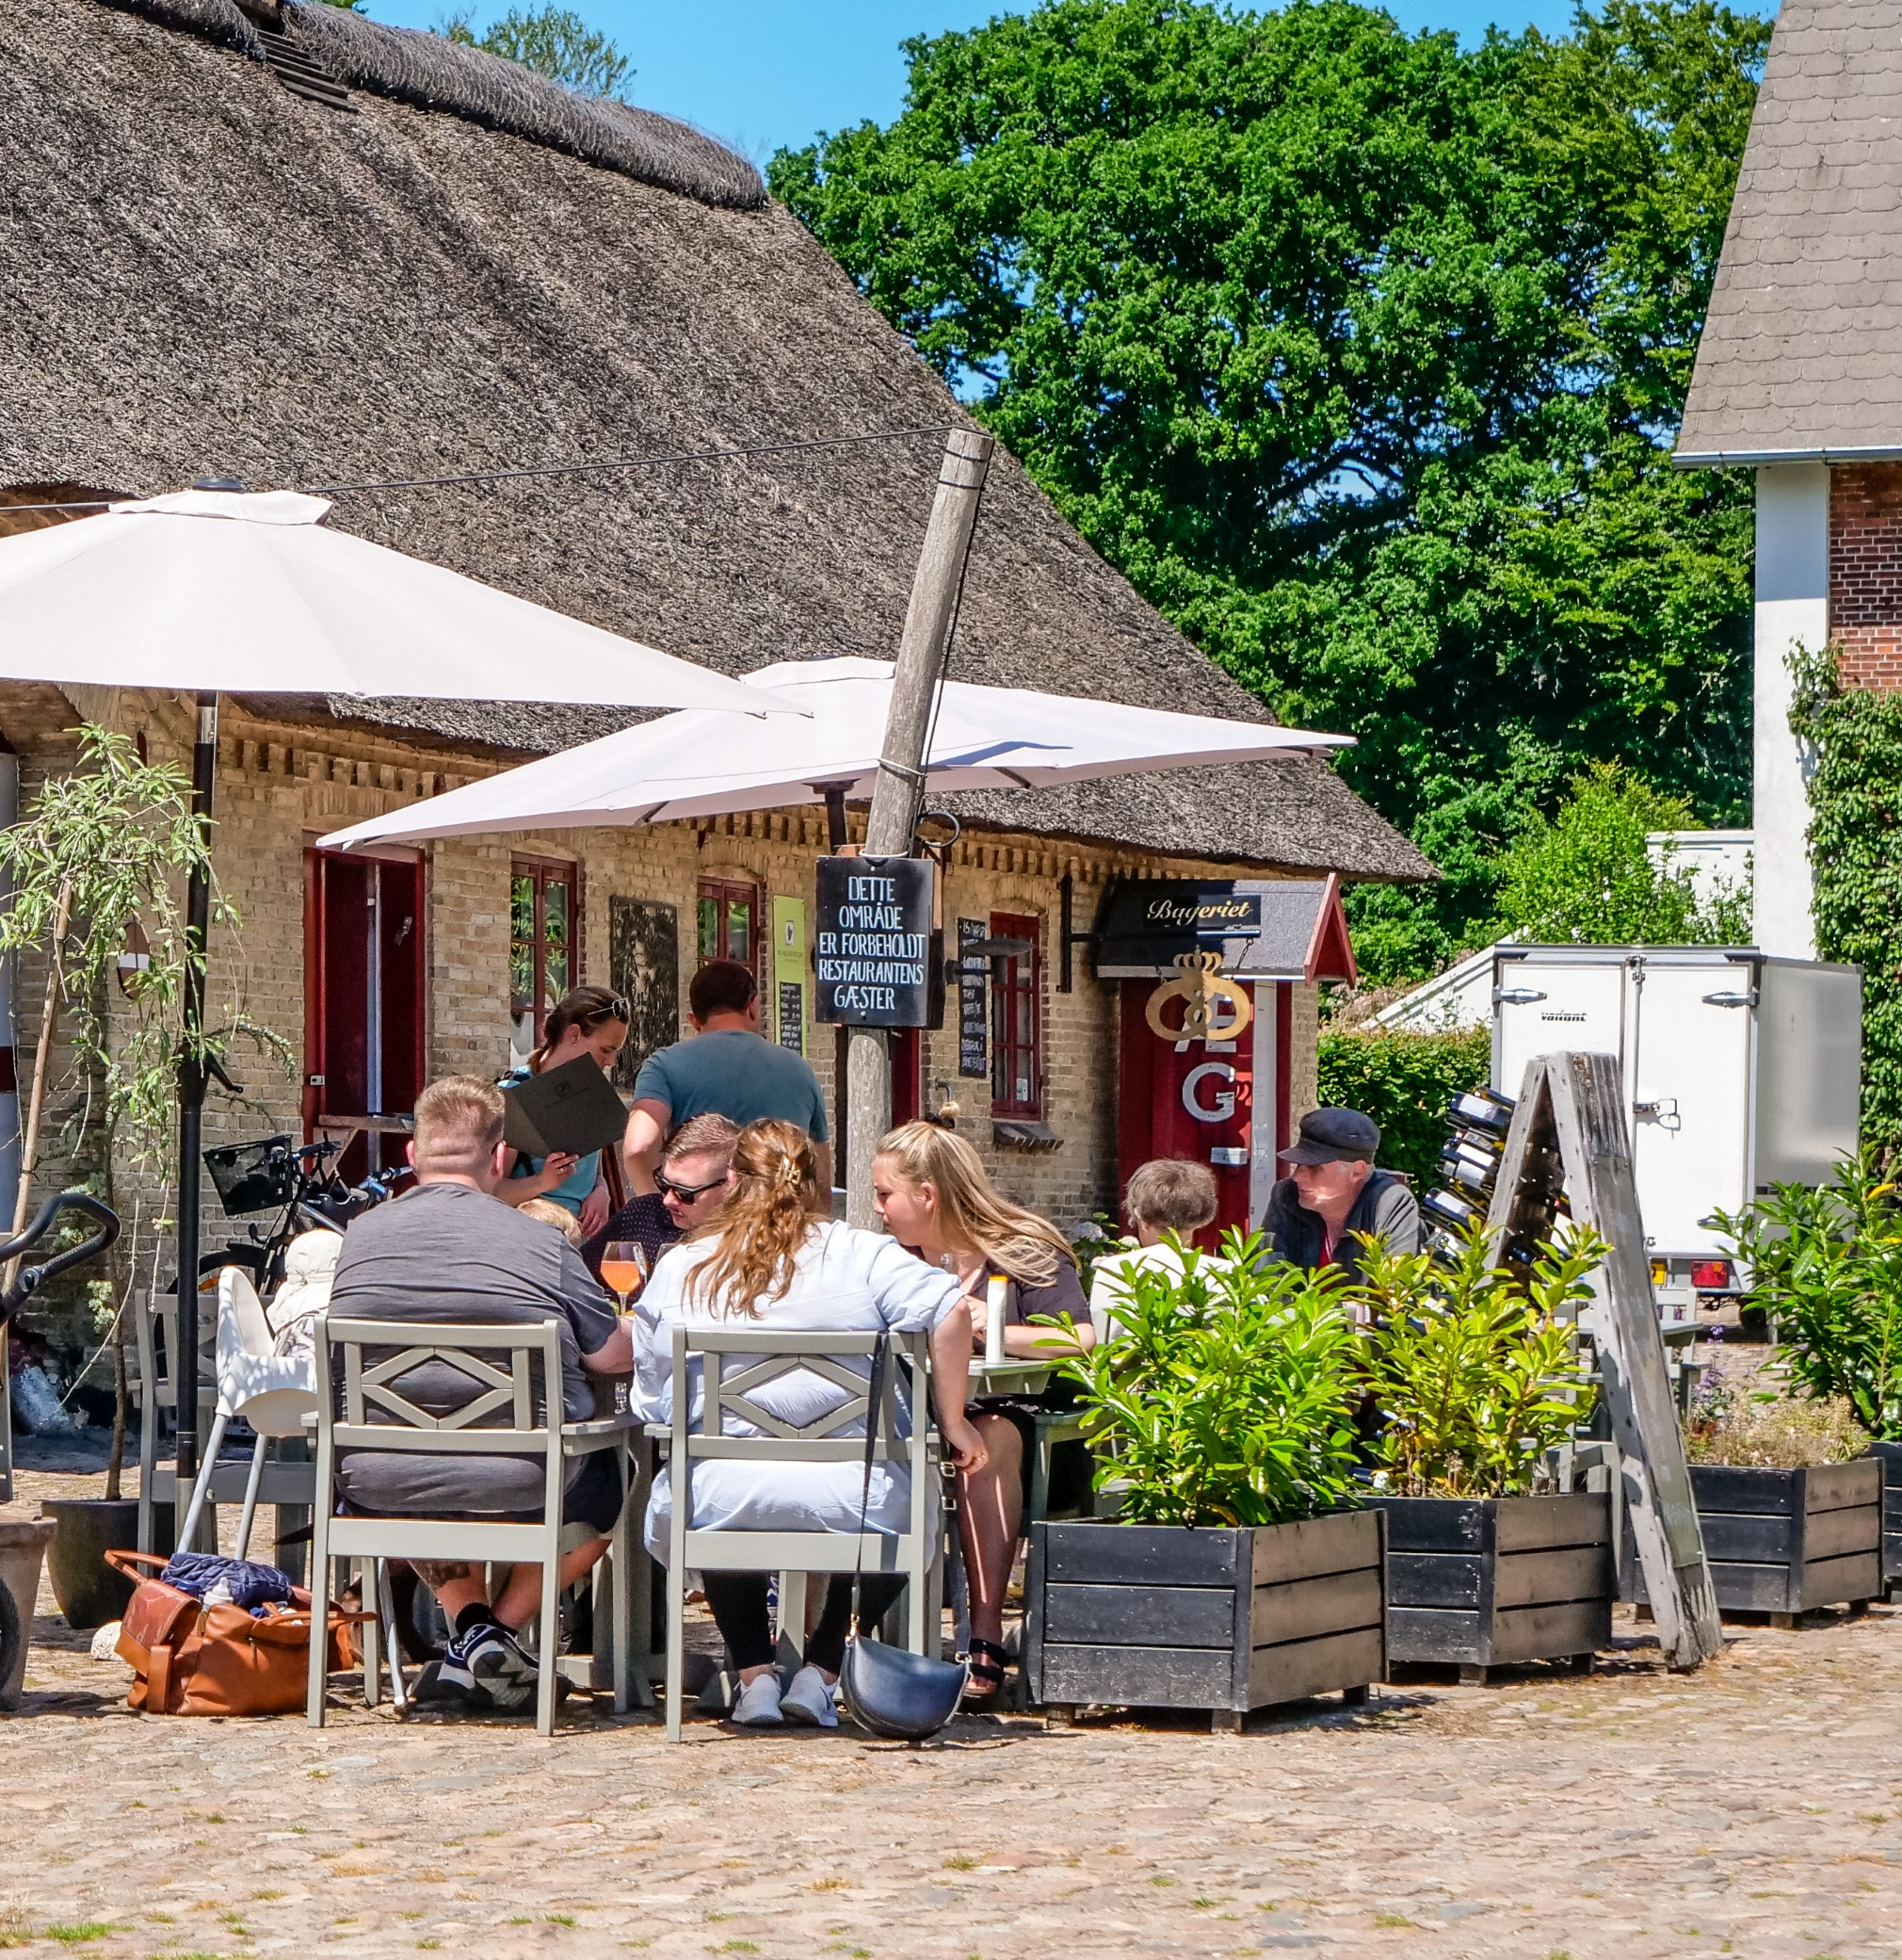
Delicacies from Fru Møllers Mølleri
In translation - Mrs. Møller’s Mill - where the miller is a woman and ‘Møller’ is her real surname. Bodil Møller is born and raised on the farm, which today is famous for its fantastic produce available from the farm shop, as well as the farm’s restaurant. The farm Bjeragerhougaard located a short way outside the coastal town of Odder is not a completely ordinary farm. Here, Bodil and Kim have created an idyllic experience centre with several shops, each with their own food production, and a delicious restaurant where the produce from the farm is used in the kitchen.

Slide 3
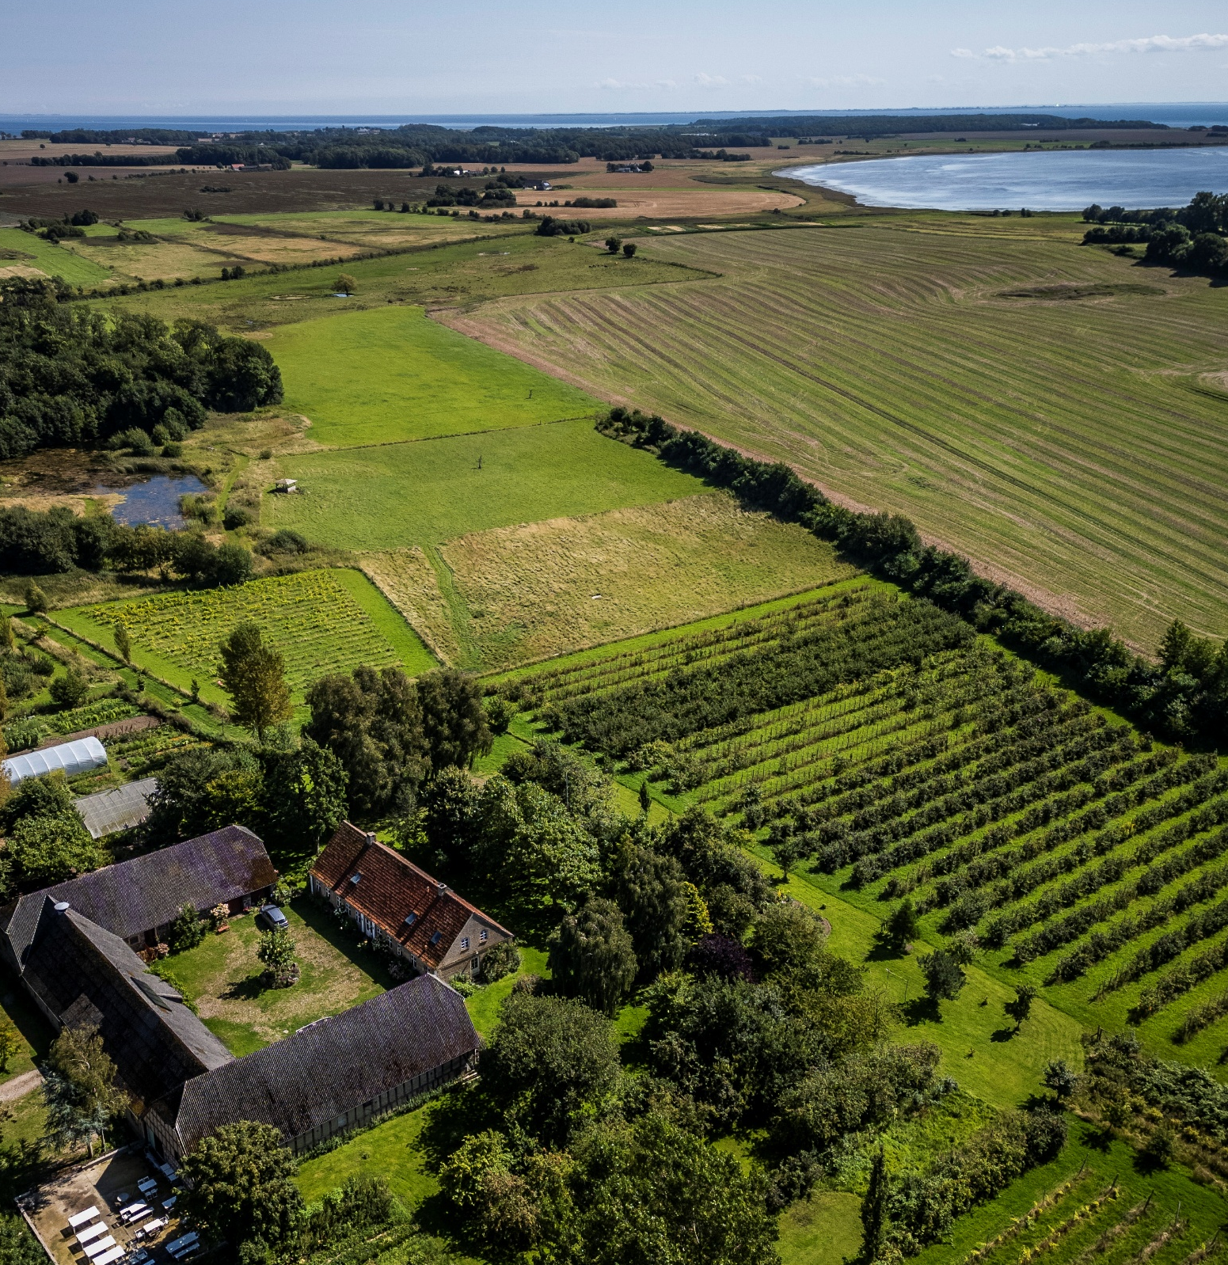
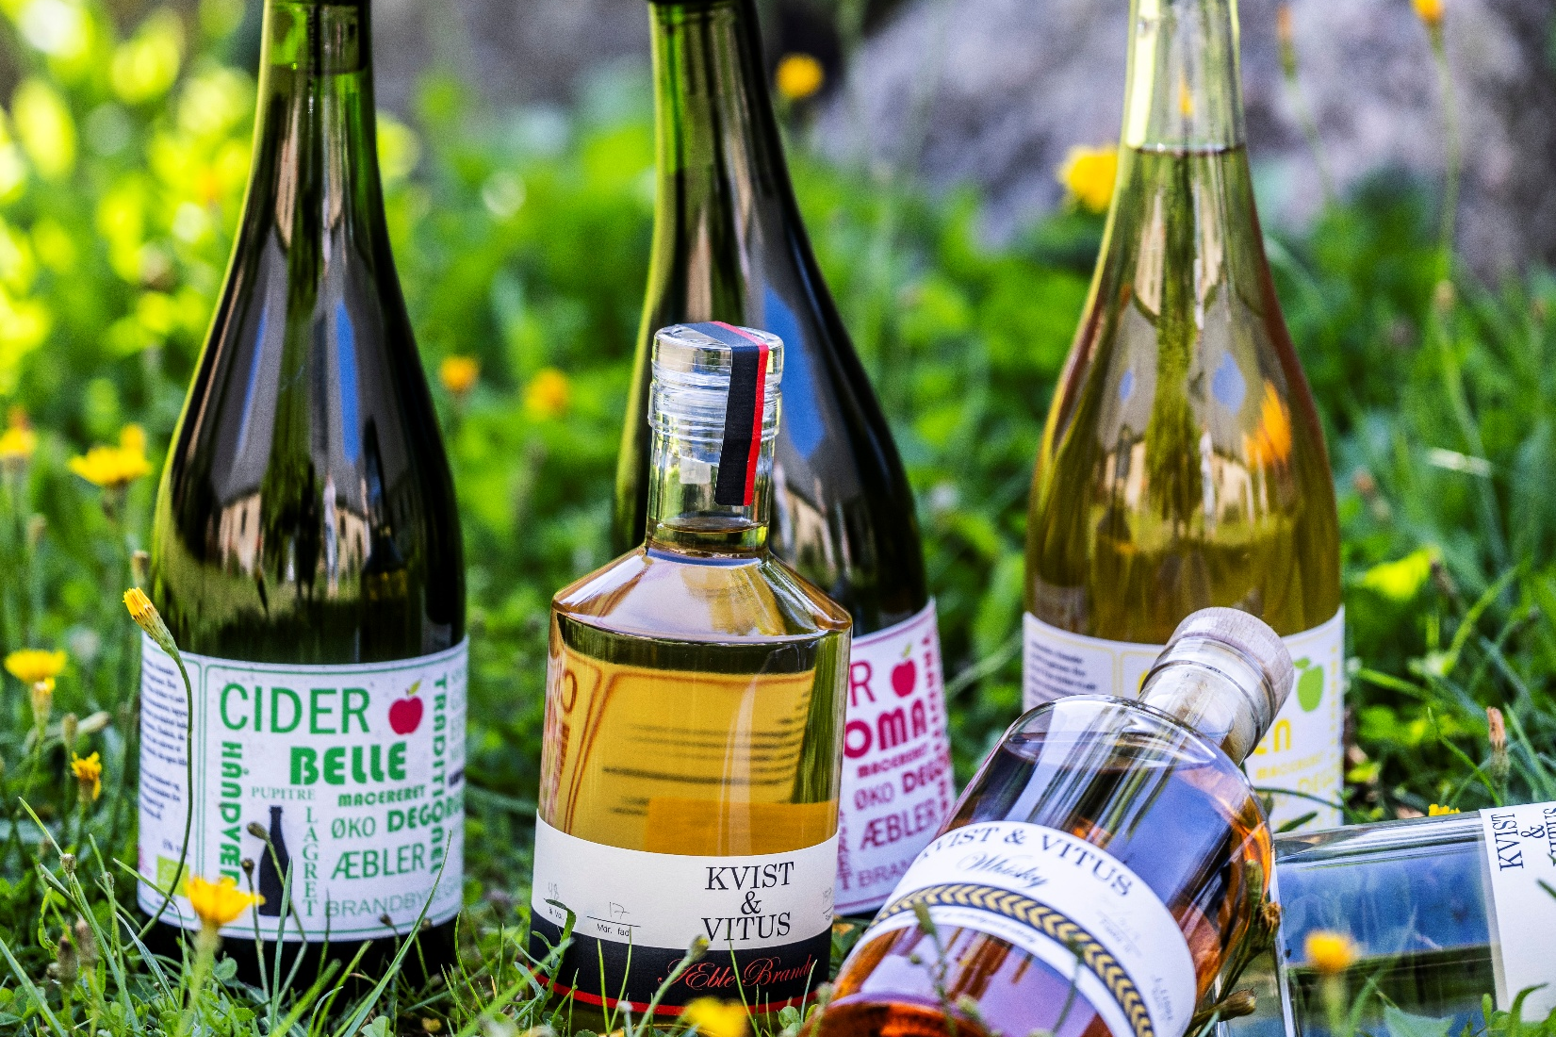
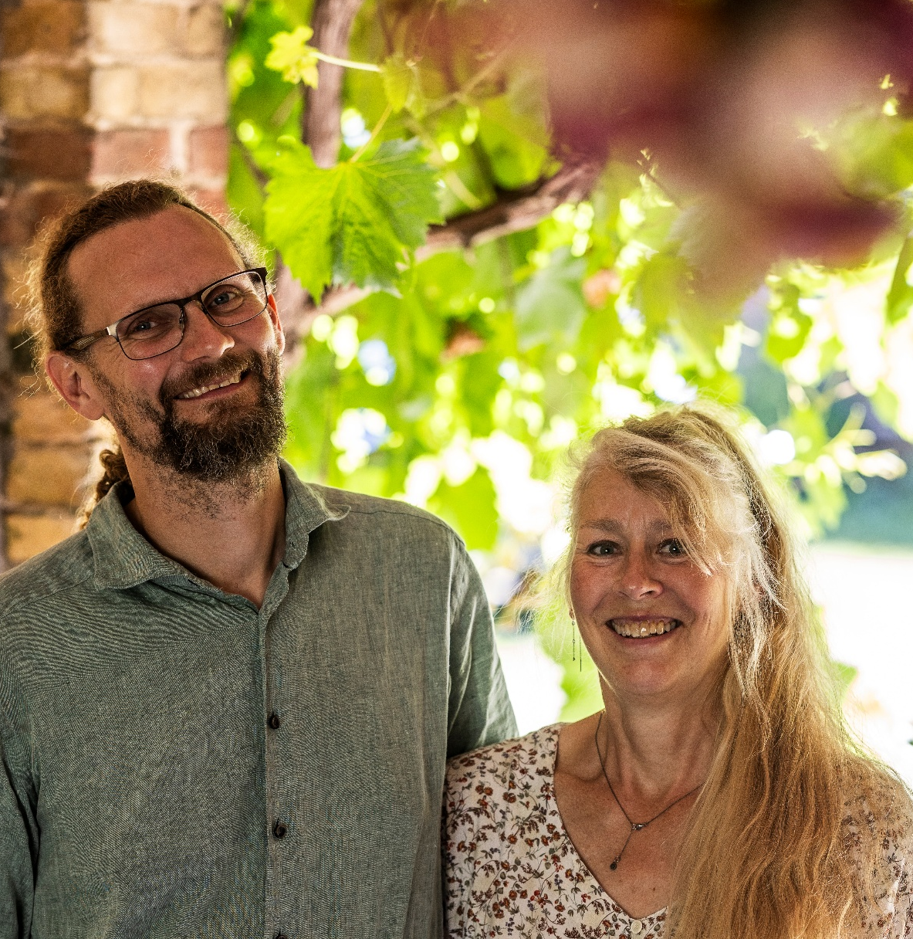
Brandbygegaard
Brandbygegaard encompasses a variety of different tasks, all handled by Søren Sørøver (Søren the pirate) and Lone Landmand (Lone the farmer). The farm is located in a lush, coastal area just north of Horsens Fjord, just a stone’s throw from the small island of Alrø.
The cultivation of fruits, berries, vegetables, etc., takes place without the use of artificial fertilizers, pesticides, or any other form of man-made chemicals. The farm holds organic authorization number 856372, and the production is monitored by both the Danish Agricultural Agency and the Danish Veterinary and Food Administration.
Both grapes and apples are used on site, and in the farm's winery and distillery, various sparkling wines are produced using the Champagne method, along with brandy, whisky, grappa, gin, and vodka. In the winter months, beer is brewed using purchased organic malt and hops, and both wines and beers can be purchased, among other places, at events featuring live music and a pop-up restaurant held throughout the year at the farm. The farm includes 25 hectares of land, but only about one-tenth is used for cultivation – the rest is left to nature. The cultivated portion consists of ½ hectare of vineyard with grapes, 1 hectare of apple orchard with various apple varieties, as well as two kitchen gardens, berry bushes, and a couple of greenhouses.
Over the years, Lone and Søren have cultivated as close to nature as possible – considering that cultivation itself is a cultural act. The connections between the soil, microorganisms, insects, birds, domestic and wild animals, plants, and humans form the foundation of life – especially here at their farm and winery. It’s about care, attentiveness, and understanding – not least of one’s own insignificance.
During the winter, when the soil and plants require less attention, the couple write books – both novels and nonfiction, such as Lone and Søren’s very popular cookbooks.

